Slide 1
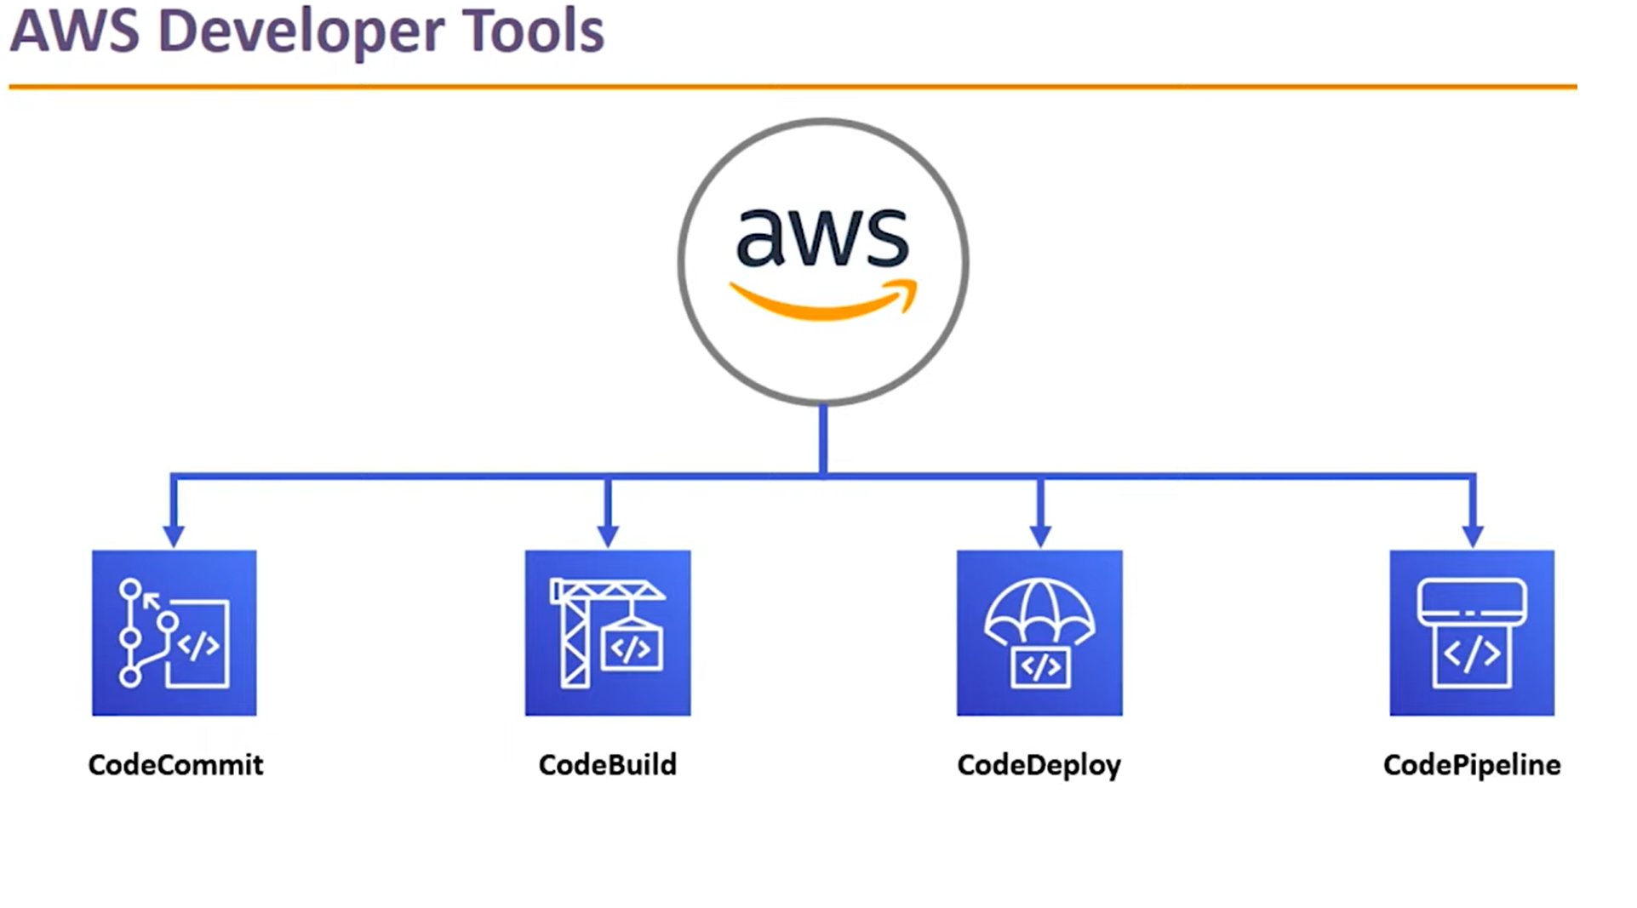

Slide 2
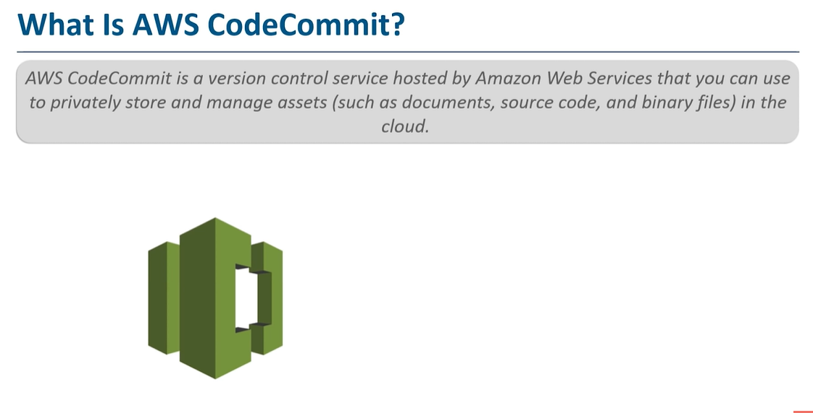
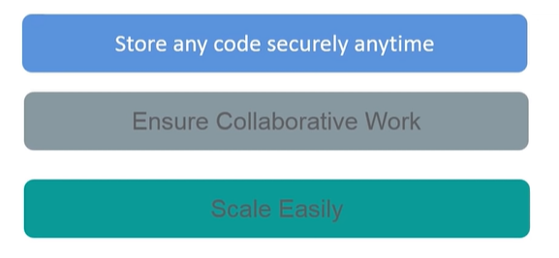
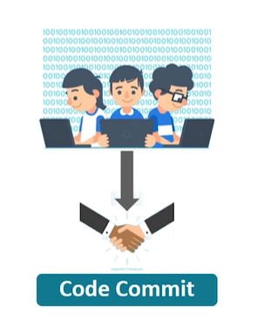

Slide 3
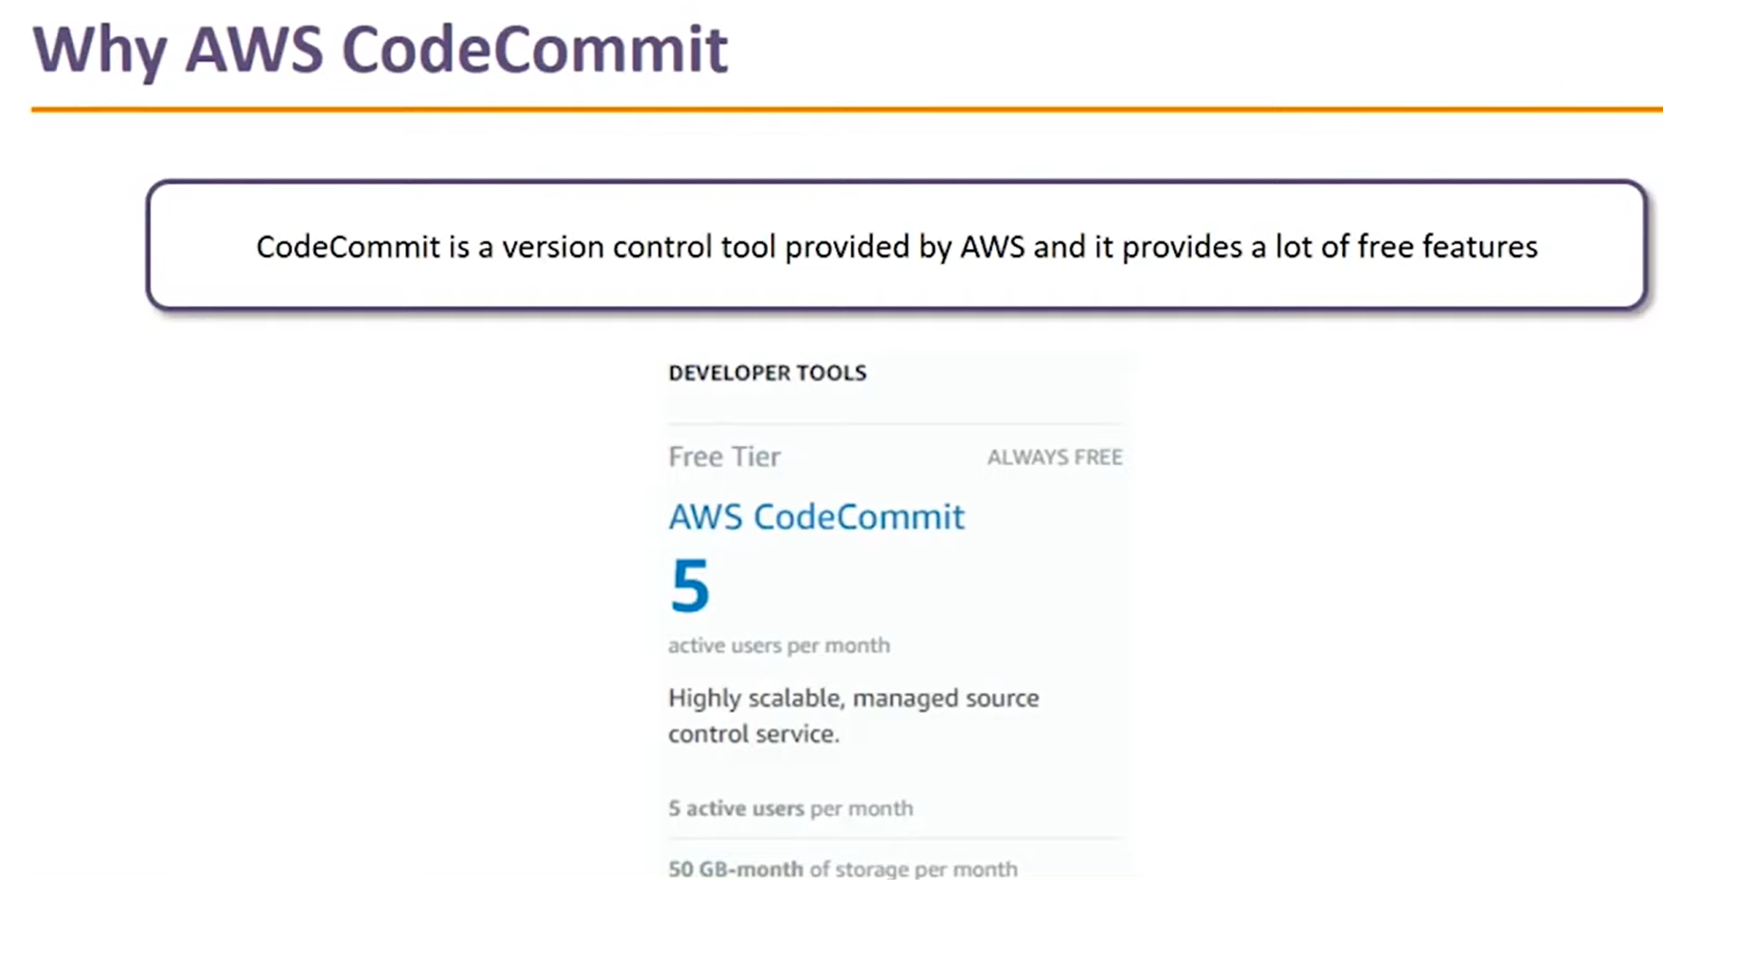
AWS CodeCommit
(1) AWS CodeCommit Tutorial -Create Repository, Add Files, Initiate Pull Requests - YouTube

Slide 4
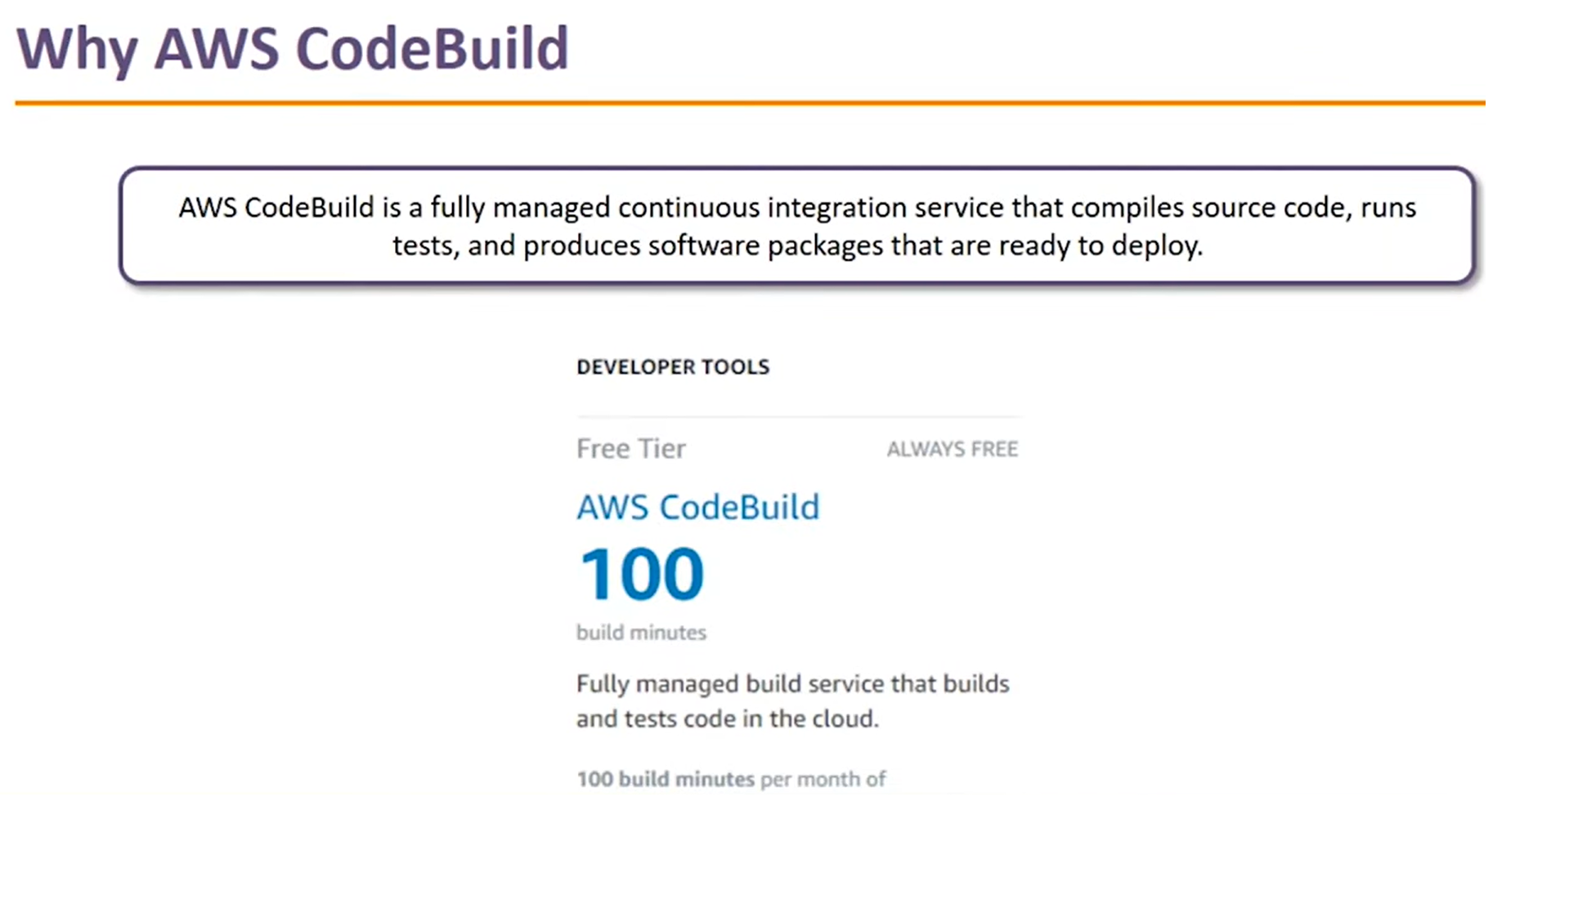
AWS CodeBuild
(1) AWS Codebuild Tutorial (Create A Deployment Package With AWS Codebuild) - YouTube

Slide 5
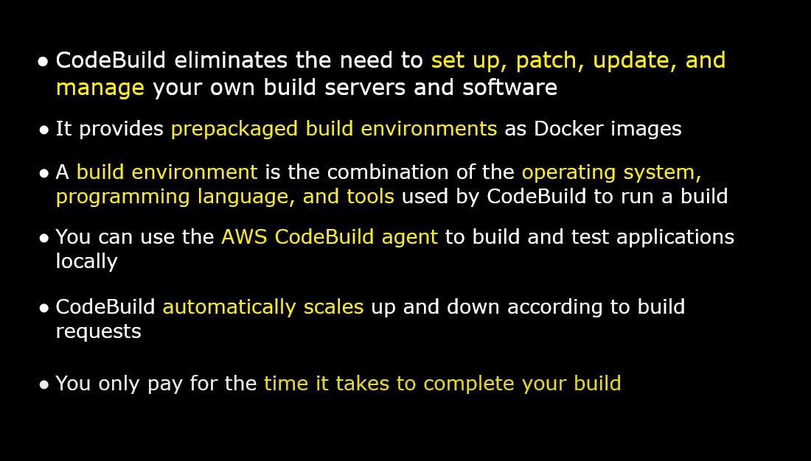

Slide 6
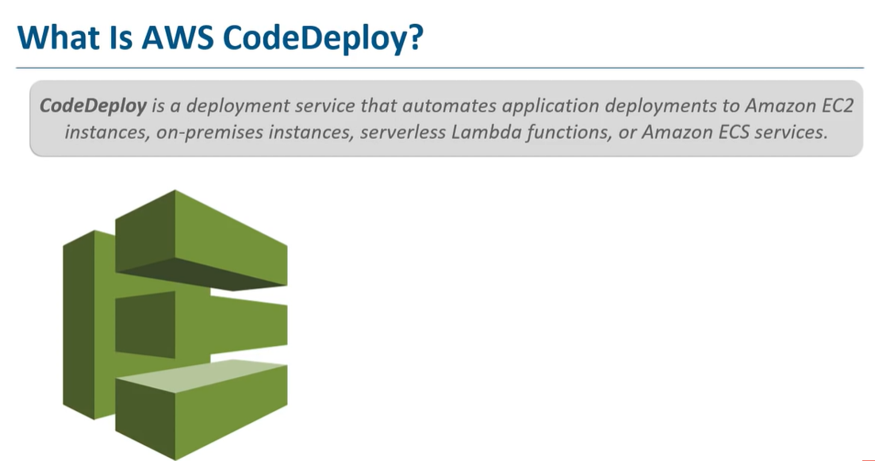
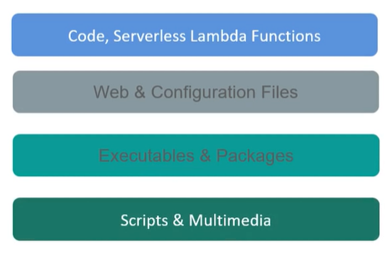

Slide 7
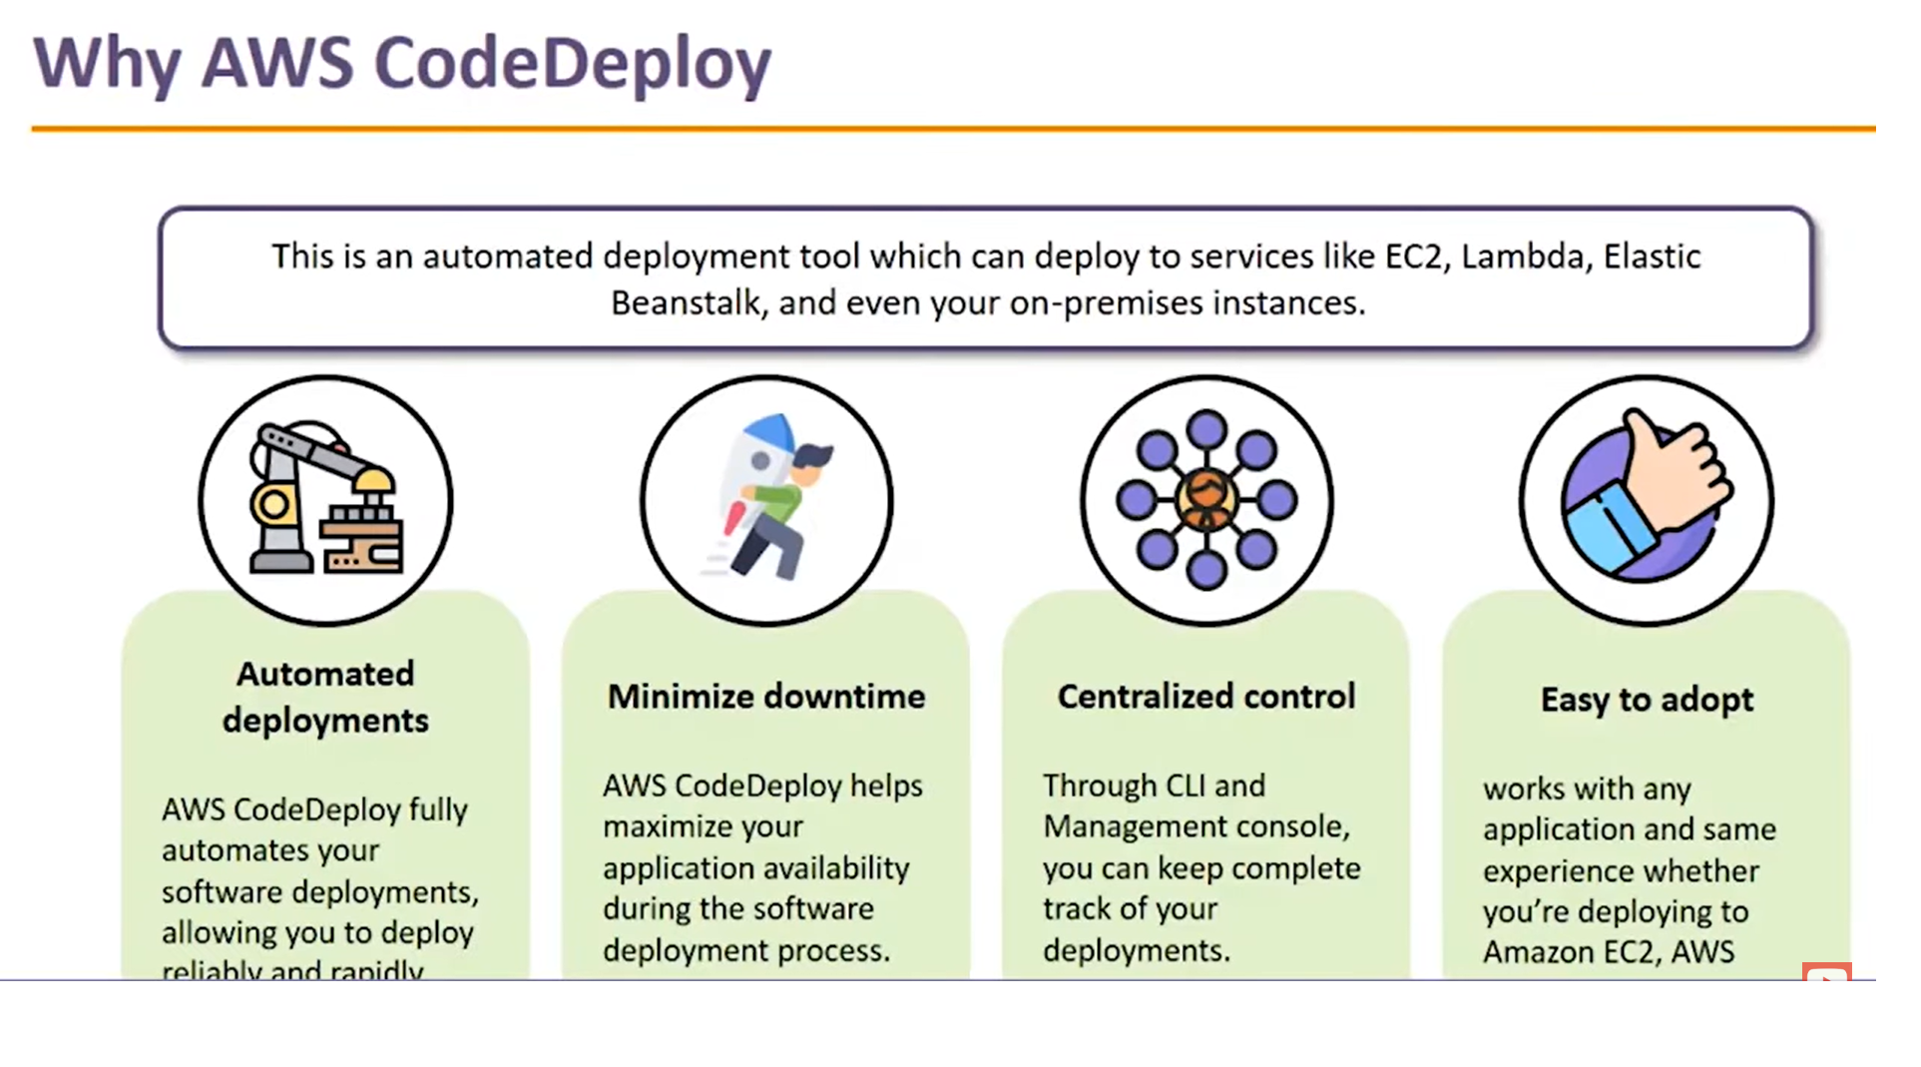
AWS CodeDeploy
(1) AWS CodeDeploy Demo (Deploy an application to EC2 Autoscaling Group) - YouTube

Slide 8
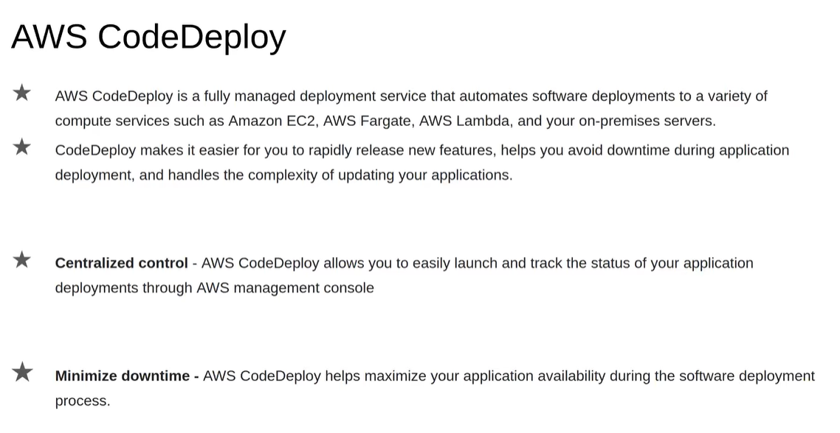

Slide 9
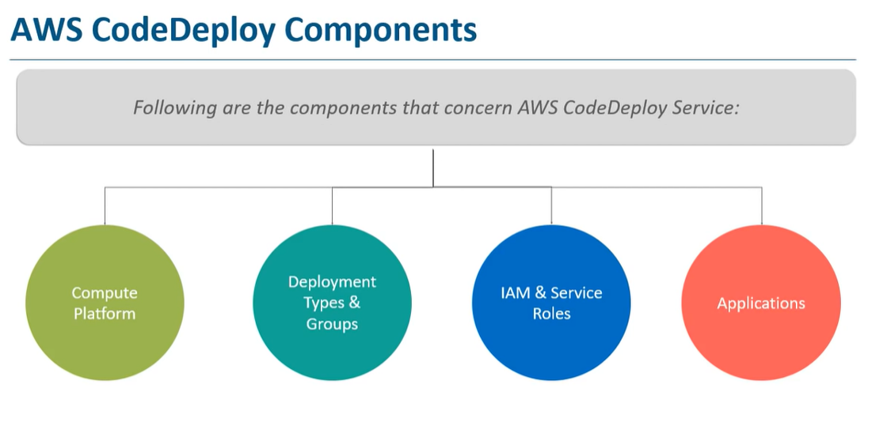

Slide 10
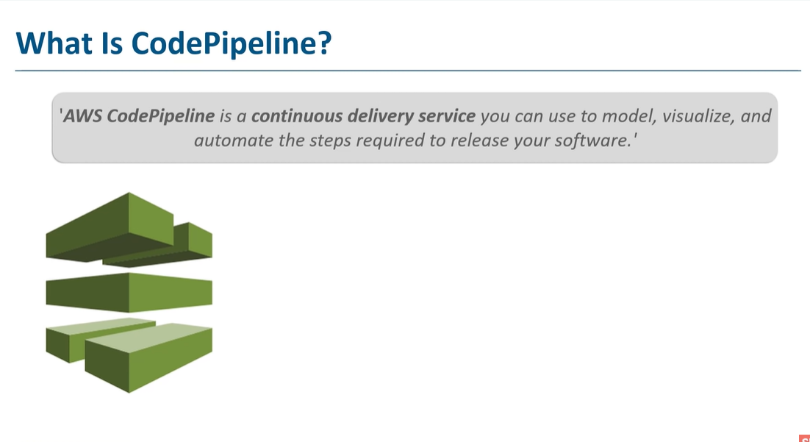
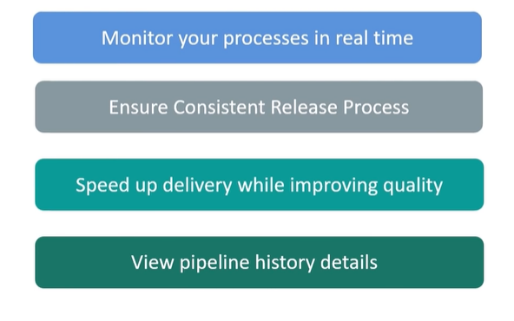

Slide 11
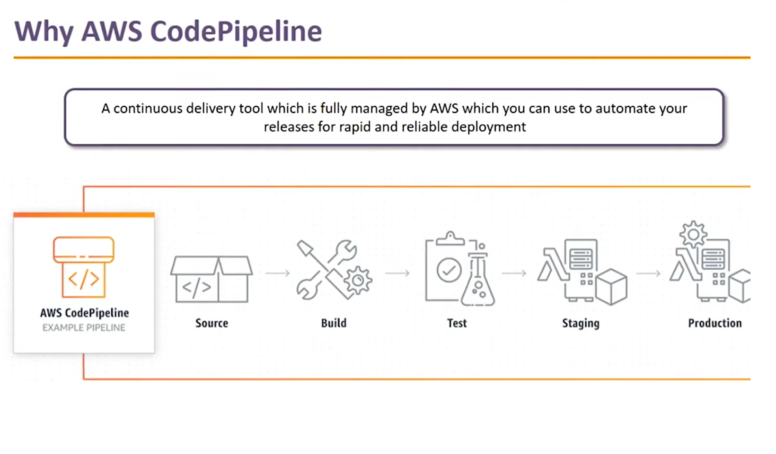
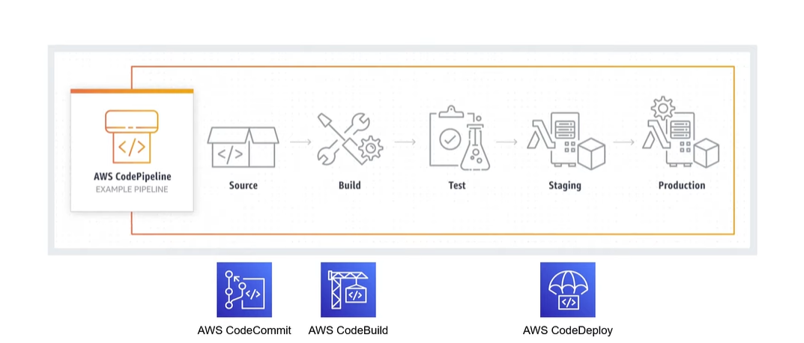
AWS CodePipeline
(1) AWS CodePipeline How To Set Up AWS CodePipeline Demo - YouTube

Slide 12
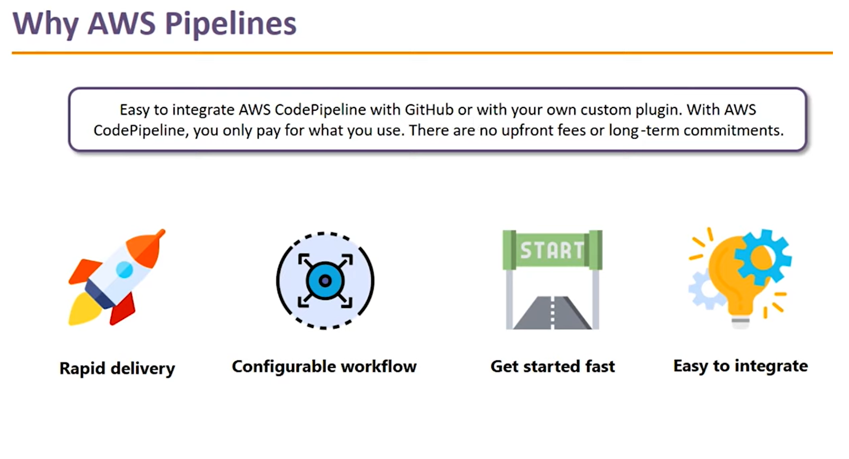

Slide 13
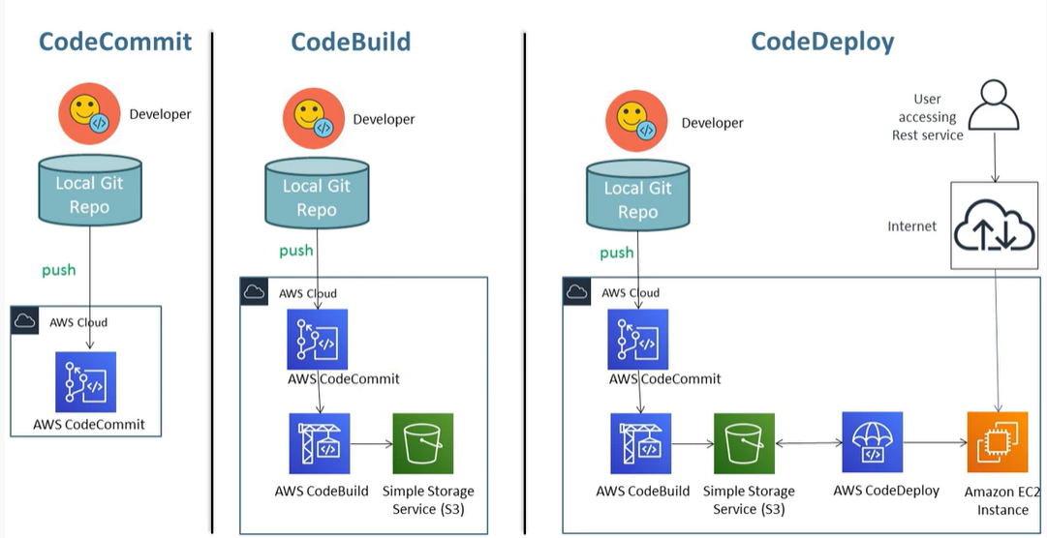

Slide 14
